Slide 1



AUTOMATED RESTOCKING OPTIMIZATION ENGINE -AROE
A Python-based system leveraging Object-Oriented Programming principles to optimize inventory management through advanced strategies:
MA5741: Object Oriented Programming
By,
Aswini V J [MA25M007] , Mehak Gupta [MA25M016],
Mousumi Sahoo [MA25M017], Nileema Mahato [MA25M018]
A Python-based system leveraging Object-Oriented Programming principles to optimize inventory management through advanced strategies:
Economic Order Quantity (EOQ)
Linear Programming (LP)
Heuristic Algorithms
Report Date: November 8, 2025
Inventory Optimization | Supply Chain Management | Automated Systems
Automated Restocking Optimization Engine (AROE) | Page 1

Slide 2













Mathematical Foundations
Core optimization models for inventory management
EOQ Model
Linear Programming
Heuristic Strategy
EOQ formula:
Decision Variables:
Safety stock formula:
Q* = √(2DS/H)
Qi ≥ 0: Order quantity
SSi = α·di
Si ≥ 0: Shortage quantity
Objective function:
Reorder point:
Cost function:
Triggeri = di + SSi = di (1+α)
min Z = Σi=1 (ciQi + hiQi/2 + p·Si)
TC(Q) = DC + (D/Q)S + (Q/2)H
Constraints:
Order quantity:
D = Annual demand
S = Ordering cost
Ii + Qi + Ai - Si ≥ diT
Qi = di × 7 × W if Ii < Triggeri
H = Holding cost
Qi ≤ Ki
Qi, Si ≥ 0, ∀i
α = Safety factor
W = Coverage weeks
Automated Restocking Optimization Engine (AROE) | Page 2

Slide 3




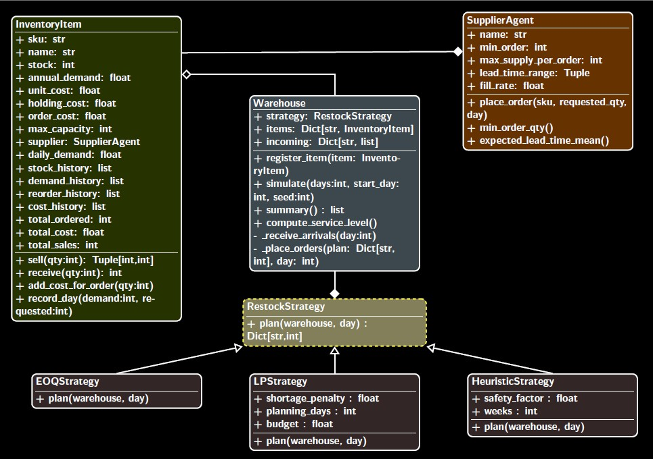





Object Oriented Design - UML Class Diagram
Inheritance
Strategies inherit from RestockStrategy. Establishes clear class hierarchy.
Polymorphism
Different strategies implement plan() uniquely. Runtime algorithm selection.
Encapsulation
InventoryItem class Encapsulates the attributes and methods of each items.
SOLID Principles
Single Responsibility Principle
Open/Closed Principle
Dependency Inversion Principle
Liskov Substitution Principle
Interface Segregation Principle
Automated Restocking Optimization Engine (AROE) | Page 3

Slide 4

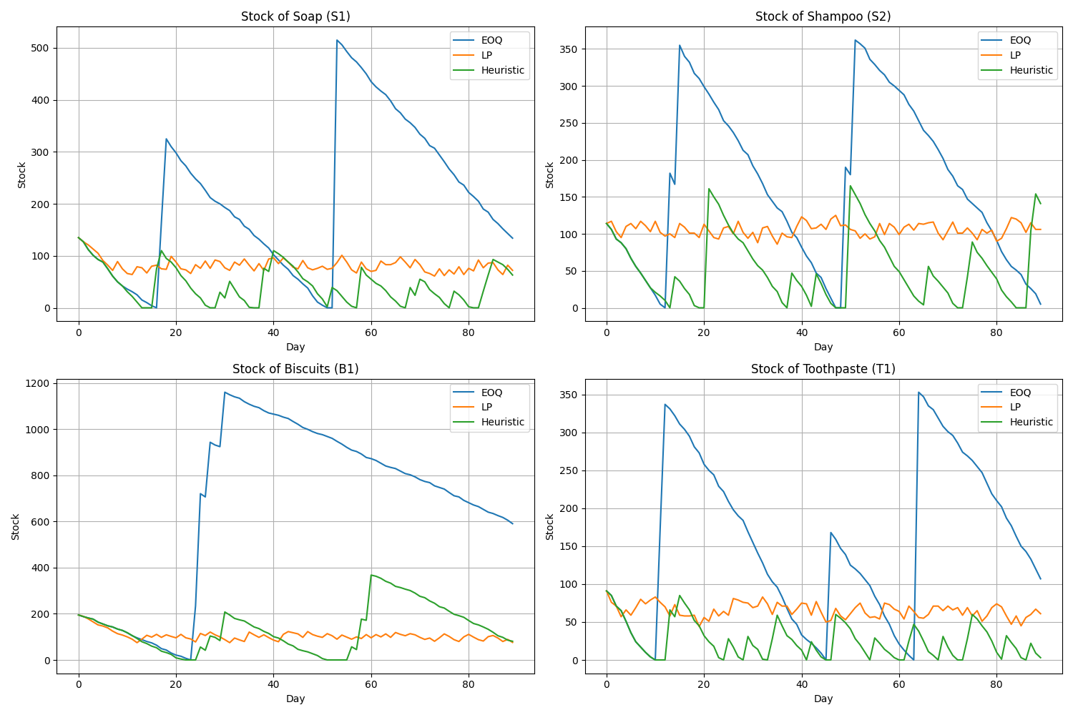

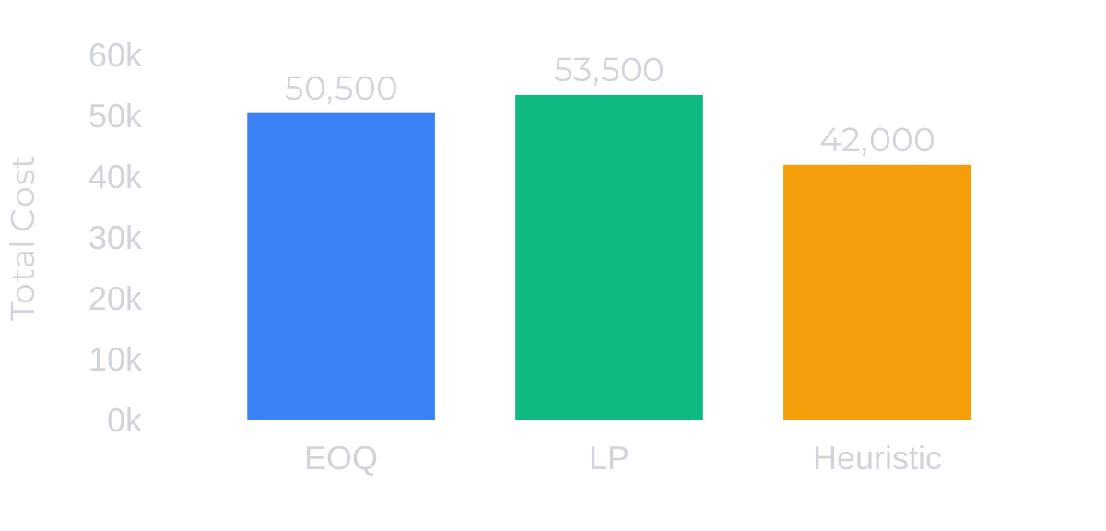




Results and Performance Analysis
Comparative analysis of three strategies
Total Cost Comparison
Key Insights
LP Strategy achieved 100% service level with highest total cost (~53,500)
EOQ Strategy balanced cost (~50,500) and performance (98.16% service level)
Heuristic Strategy minimized cost (~42,000) at expense of lowest service level (91.01%)
Automated Restocking Optimization Engine (AROE) | Page 4

Slide 5









Conclusions and Future Directions
Project achievements, current limitations, and roadmap for enhancements
Project Achievements
Current Limitations
Future Directions
Successful implementation of OOP principles (encapsulation, inheritance, polymorphism)
Simple demand modeling without seasonality or trend patterns
Short-term
Integrate RL strategies, advanced demand forecasting, and enhanced testing
Single warehouse implementation lacks multi-echelon support
Applied strategy pattern for flexible algorithm selection
Mid-term
Add multi-echelon support, robust optimization, and interactive GUI
LP strategy in our AROE system is not constrained realistically considering confounding variables like
seasonal stocks, version improved products.
Strict adherence to SOLID principles ensuring maintainability
Long-term
Implement database integration, microservices architecture
Performance insights: LP provides optimal results with higher computational cost on a well constrained setup
This project demonstrates how OOP principles can transform complex mathematical optimization into elegant, maintainable software architecture—bridging the gap between theory and industrial applications.
Automated Restocking Optimization Engine (AROE) | Page 5

